Slide 1

Presentation of the CseGe kft. Network Prototype
Made by: Elekes Bálint, Győrfi Dániel, Szőts Dávid

Slide 2
Introduction
Bálint Elekes- Project Manager and Lead Network Configuration Specialist
Main tasks:
Designing and implementing the complete network architecture
Detailed configuration of routers and switches in Cisco Packet Tracer
Setting up VLANs and inter-VLAN routing (router-on-a-stick / multilayer switch)
Configuring network security solutions: ACLs, Port Security, NAT, DHCP, DNS, FTP, and web services
Routing settings (statikus routs, OSPF)
Deploying a multilayer switch in the development network
Monitoring network operation and troubleshooting issues
Contribution to the project:
Key role in the technical implementation of the network
Developing a secure and functional corporate network prototype
Professional guidance and technical coordination of the project

Slide 3
Dániel Győrfi – Network Design and Basic Configuration
Main Tasks:
Designing the logical and physical structure of the network
Contribution to the Project:
Establishing site and department-level network structure Providing a stable foundation for further configurations
Basic configuration of routers and switches
Creating VLANs and connecting endpoints
Planning IP addressing (static and dynamic)
Testing connections (ping, traceroute)

Slide 4
Dávid Szőts – Project administration and support
Main tasks:
Create, update and track Jira tasks
Contribution to the project:
Ensuring project transparency using Jira
Manage time spent (worklog) Complete network configuration tasks more easily Support testing process (record PASS / FAlL cases)
Addition and review documentation
Administrative and technical support for the team
Assisting with testing and documentation tasks

Slide 5
Brief overview of CseGe Kft.
The network models the operation of a medium-sized company with multiple departments
The network is segmented with VLANs, each department having its own subnet
Inter-VLAN routing enables communication between VLANs
Core network services include:
DHCP
DNS
FTP and Web server
Security is ensured via ACLs, port security, and NAT
The prototype was created in Cisco Packet Tracer, simulating a real corporate environment

Slide 6
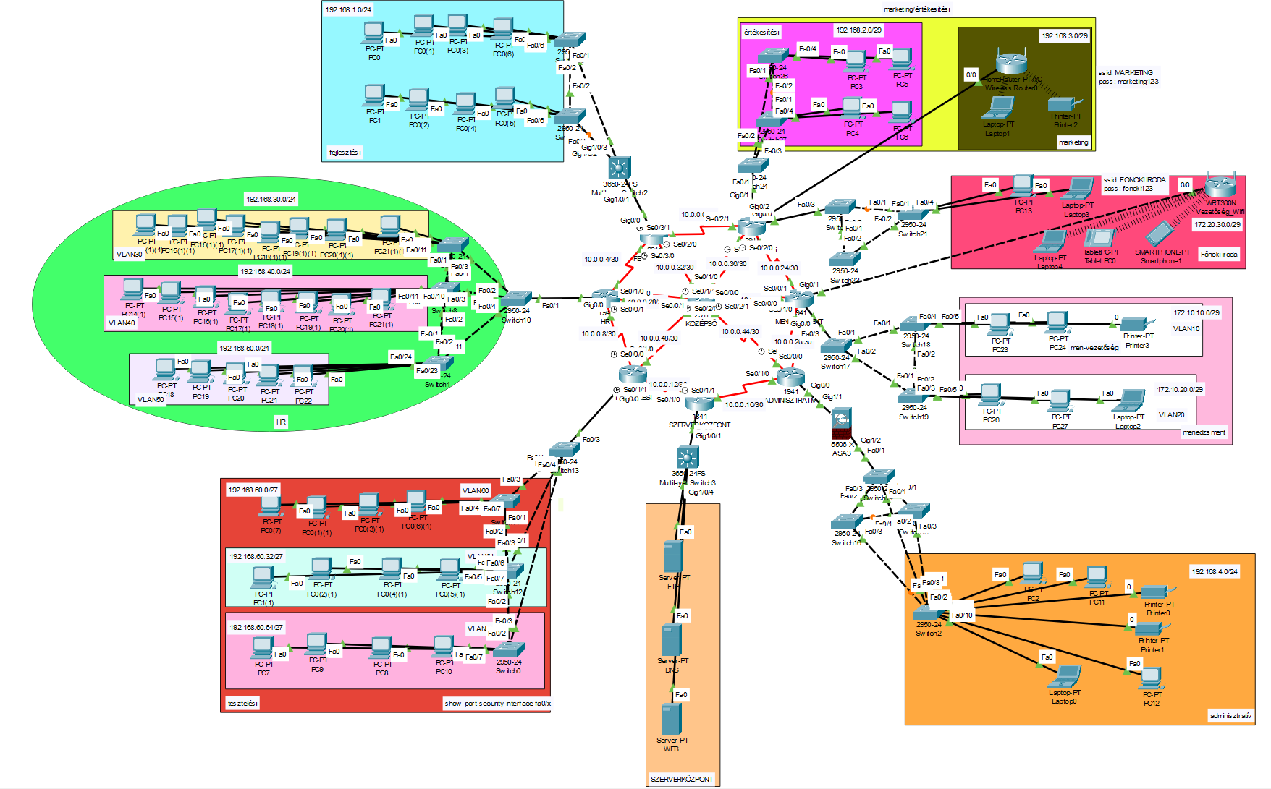
The whole Prototype

Slide 7
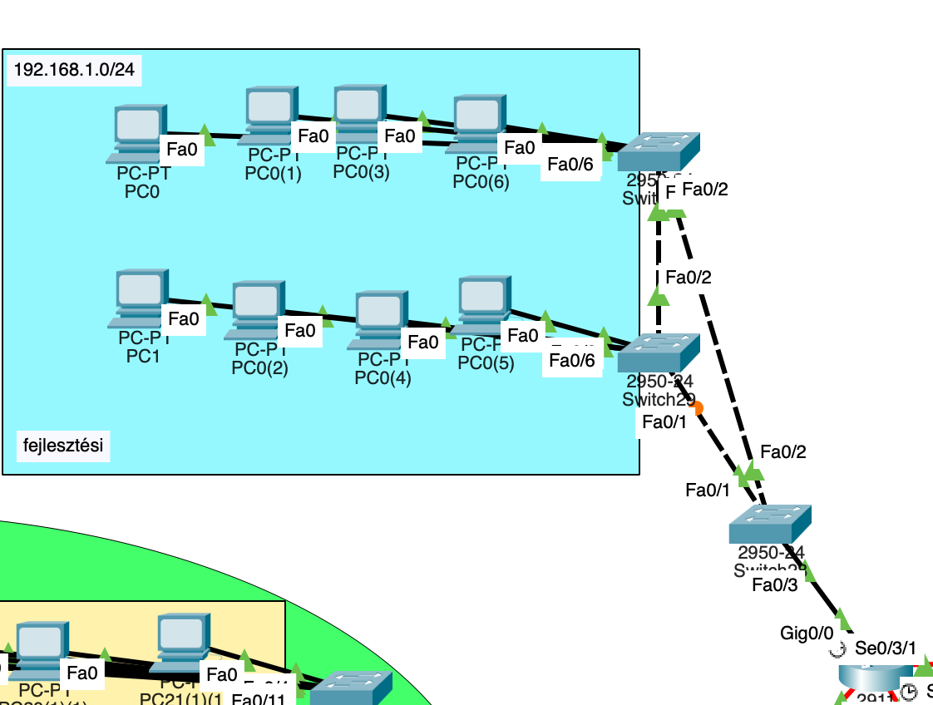

Development Department
Router: FEJLESZTESI
VPN endpoint: Tunnel0 – 172.16.10.1
IPv6 Dual Band
Functions:
  DHCP, DNS, VPN connections
  Static route: 192.168.2.0 → via VPN
  RIP network participation (10.0.0.0 + 192.168.1.0)

Slide 8
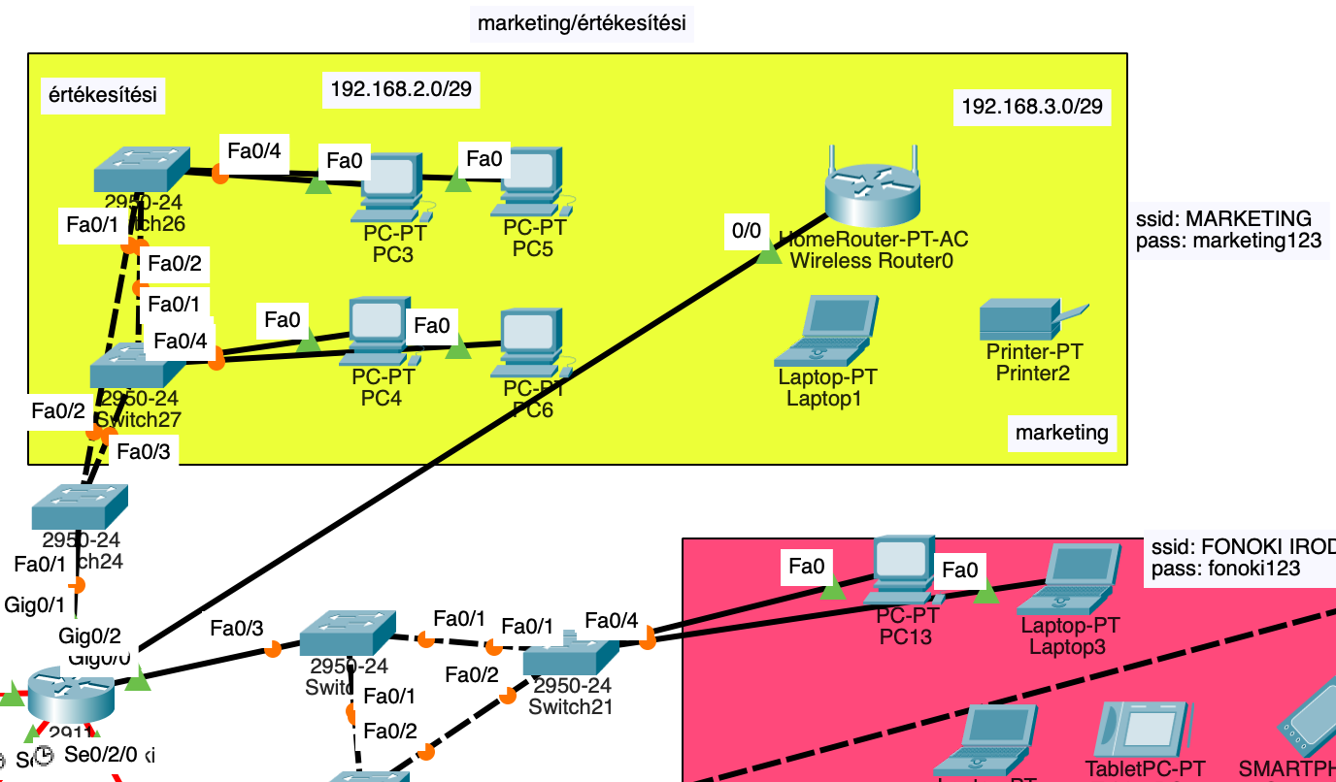
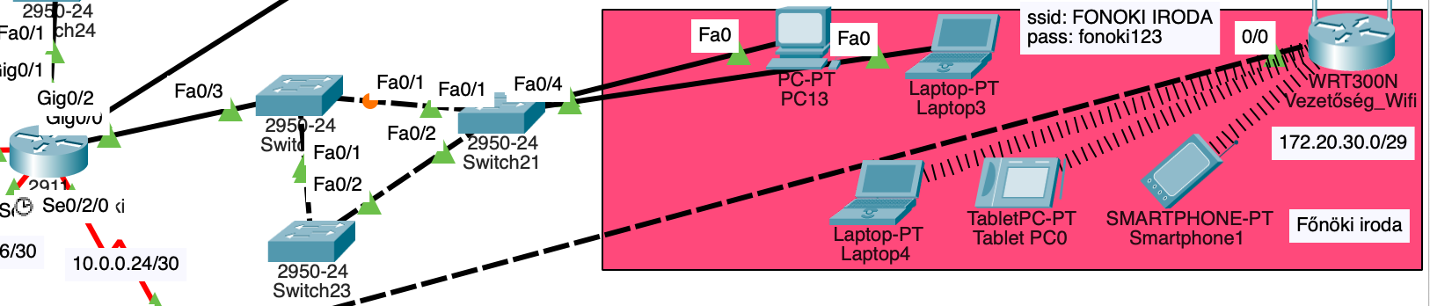
Marketing/Sales Department, Executive Office
Router: MAR/ERT_Fonoki
Classes:
  Marketing/Sales
  Boss office
  LAN at Boss office
  Wifi router LAN
Functions:
  VPN connection to Development site (172.16.10.2)
  DHCP 3 for 3 separate networks
  RIP + static route

Slide 9
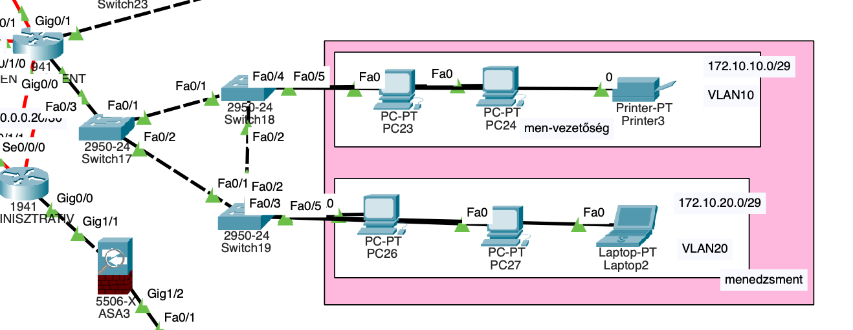
Management department
Router: MENEDZSMENT
VLANs: 10, 20
ACL 101 protects traffic between the two VLANs
DHCP separate pools: management10 / management20

Slide 10
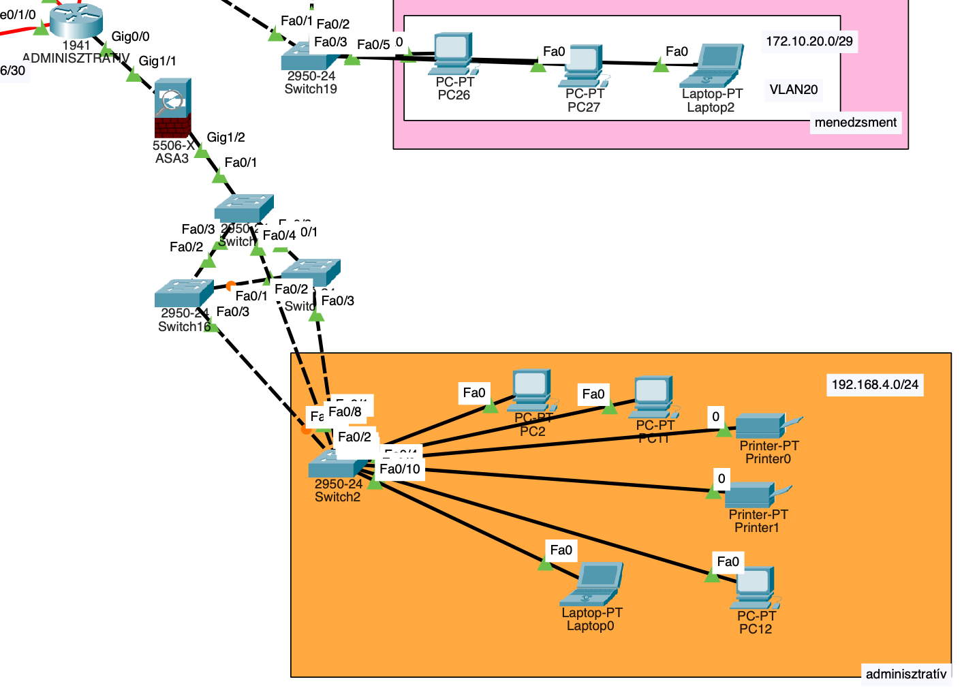
Administrative department
Router: ADMINISZTRATIV
Connected to ASA2 firewall (Gig0/0 ↔ ASA outside 10.0.16.0/30)
DHCP: 192.168.4.0/24
RIP + static route
ASA functions:
  NAT (inside ↔ outside)
  Security levels: inside 100, outside 0
  Allows traffic only from inside out

Slide 11
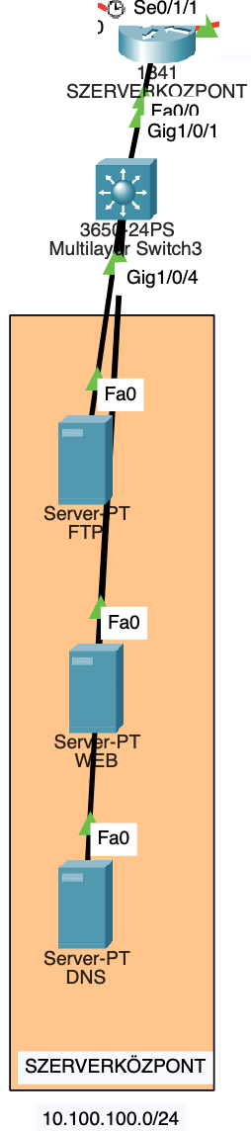
Server center
Router: SZERVERKOZPONT
Includes:
  FTP server
  DNS server
  Web server
  Web accessible via DNS name: csegekft.com
RIP connection to the core network

Slide 12
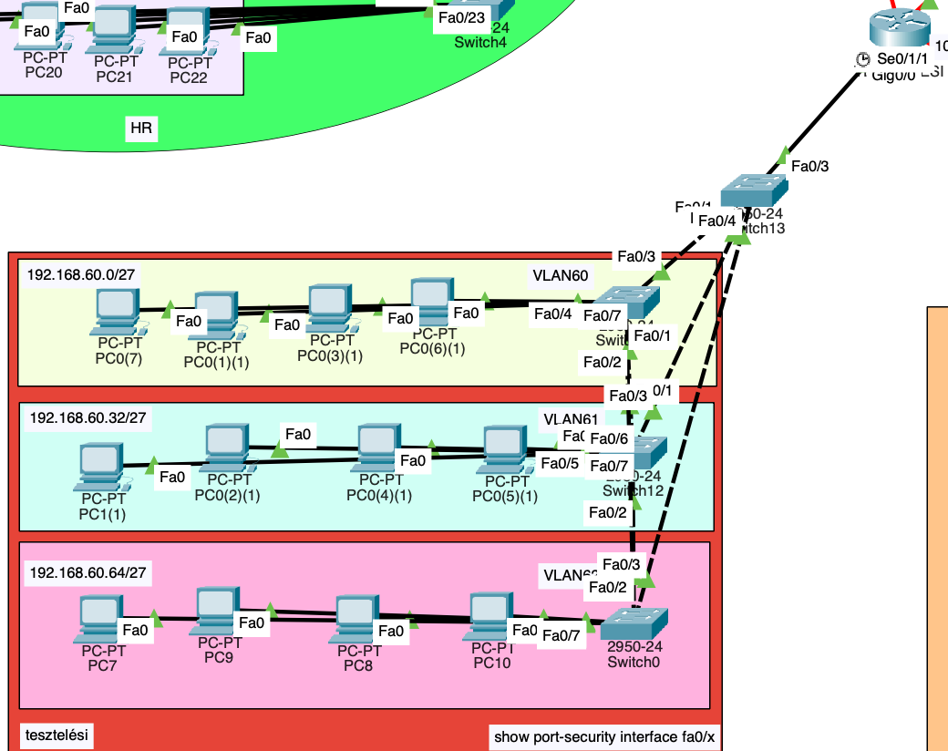
Testing class
Router: TESZTELESI
VLANs: 60, 61, 62
Trunk connection to the switch
DHCP for VLANs
Switch security:
  Port Security (max 2 MACs, restrict)
  PortFast, BPDU Guard
  Sticky MAC addresses configured

Slide 13
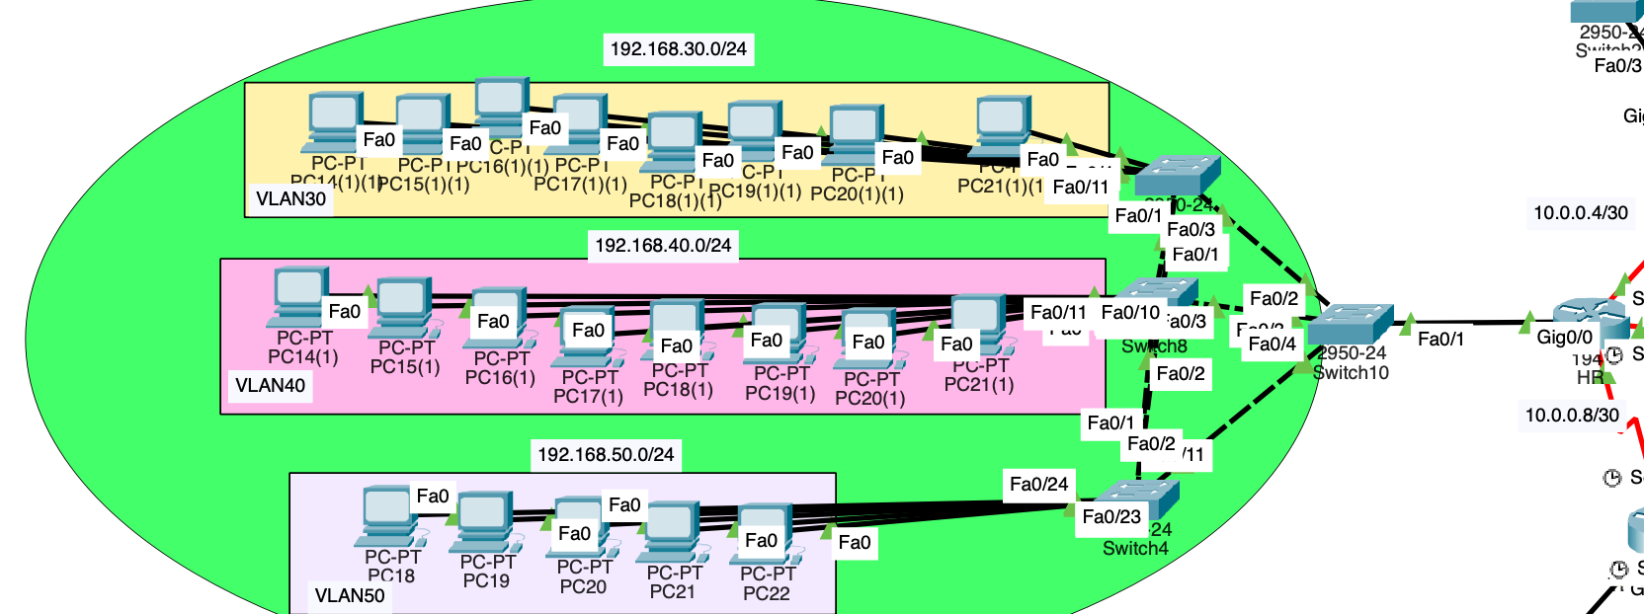
HR class
Router: HR
VLANs: 30, 40, 50
DHCP different subnet mask
RIP routing 10.0.0.0 + 192.168.x.x networks

Slide 14

What is the GIT?
Open-source version control system)
Tracks changes in source code and configurations
Manages versions and branches
Allows reverting to previous states
Integrates with GitHub and other repositories

Slide 15
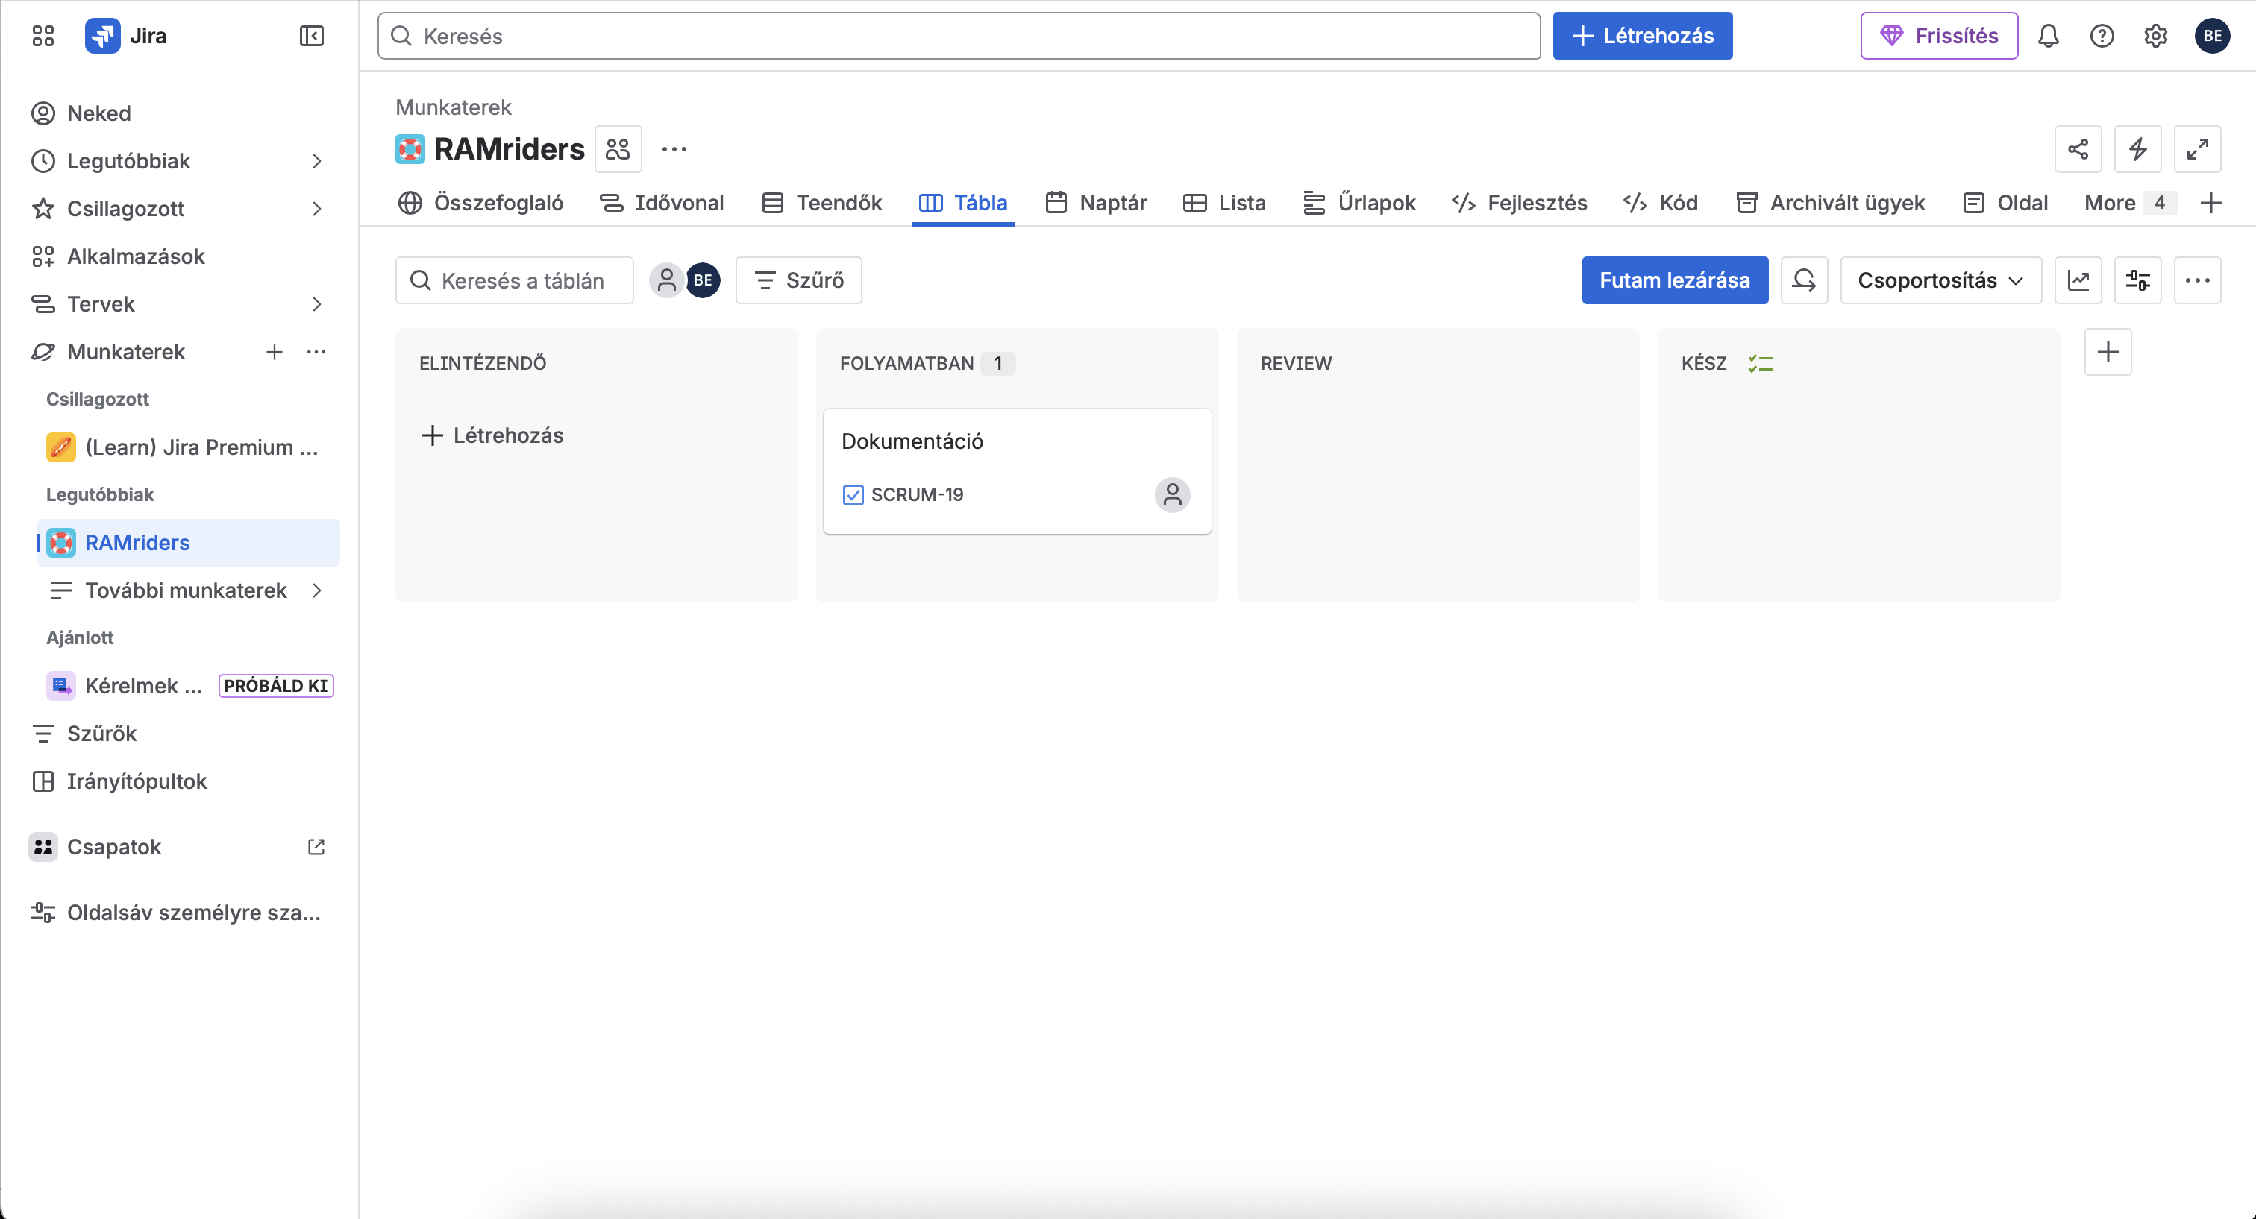
Mi az a JIRA?
What is the JIRA?
Project and task management tool (by Atlassian)
Issue and task tracking
Team collaboration and deadline management
Transparent workflow and status tracking
Time tracking and reporting

Slide 16
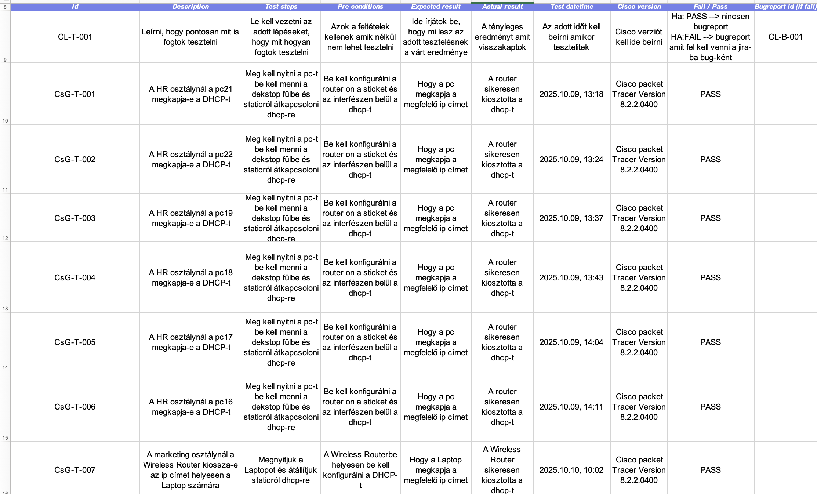
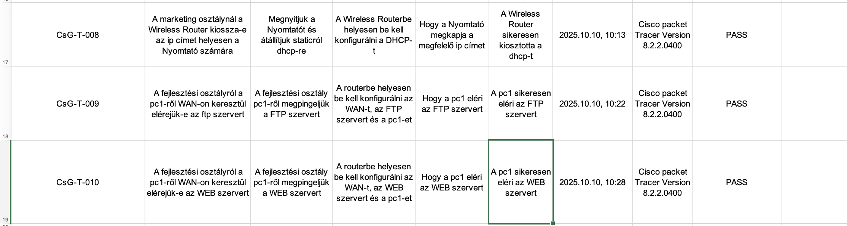
Testing scheme

Slide 17
Overview
Fully functional multi-site corporate network
VPN connection between headquarters and branches
DNS + Web integration
Complete network security (firewall, ACL, port-security)

